Slide 1


The constructional semantics of aspect in Russian
Laura A. Janda, UiT The Arctic University of Norway
Robert J. Reynolds, Brigham Young University

Slide 2
Overview
Russian aspect and constructions
An experiment on Russian aspect
Ambivalent and categorical constructions
Russian aspect in the Russian Constructicon

Slide 3
Russian aspect and constructions

Slide 4
Aspectual contrasts available in Russian
 | Perfective | Imperfective
Past | napisal ‘he wrote’ vyigral ‘he won’ | pisal ‘he wrote’ vyigryval ‘he won’
Present | [No aspectual contrast available] | pišet ‘s/he writes’ vyigryvaet ‘s/he wins’ (Non-Past)
Future | napišet ‘s/he will write’ vyigraet ‘s/he will win’ (Non-Past) | budet pisat’ ‘s/he will write’ budet vyigryvat’ ‘s/he will win’
Infinitive | napisat’ ‘write’ vyigrat’ ‘win’ | pisat’ ‘write’ vyigryvat’ ‘win’
Imperative | napišite ‘write!’ vyigrajte ‘win!’ | pišite ‘write!’ vyigryvajte ‘win!’

Slide 5
The constructions we know about
Certain lexical “triggers/cues” are known to determine aspect
BUT: How often are these triggers/cues available?
In other words, what percentage of verbs appear in collocation with triggers/cues?
 | Adverbials as triggers | Verbs as triggers
Perfective | nakonec ‘finally’, vnezapno ‘suddenly’, srazu ‘immediately’, čut’ ne ‘nearly’, vdrug ‘suddenly’, uže ‘already’, neožidanno ‘unexpectedly’, sovsem ‘completely’, za tri časa ‘in three hours’… | zabyt’ ‘forget’, ostat’sja ‘remain’, rešit’ ‘decide’, udat’sja ‘succeed’, uspet’ ‘succeed’, spešit’ ‘hurry’…
Imperfective | vsegda ‘always’, často ‘often’, inogda ‘sometimes’, poka ‘while’, postojanno ‘continually’, obyčno ‘usually’, dolgo ‘for a long time’, každyj den’ ‘every day’, vse vremja ‘all the time’, tri časa ‘for three hours’… categorical negation: ne nado ‘should not’, ne stoit ‘not worth’, ne razrešaetsja ‘not allowed’… | Verbs of motion: pojti ‘go’, etc. Others: učit’sja ‘learn’, umet’ ‘know how’, ljubit’ ‘love’…

Slide 6

The constructions we know about
What about the 98% of constructions we don’t know about?
 | Adverbials as triggers | Verbs as triggers
Perfective | nakonec ‘finally’, vnezapno ‘suddenly’, srazu ‘immediately’, čut’ ne ‘nearly’, vdrug ‘suddenly’, uže ‘already’, neožidanno ‘unexpectedly’, sovsem ‘completely’, za tri časa ‘in three hours’… | zabyt’ ‘forget’, ostat’sja ‘remain’, rešit’ ‘decide’, udat’sja ‘succeed’, uspet’ ‘succeed’, spešit’ ‘hurry’…
Imperfective | vsegda ‘always’, často ‘often’, inogda ‘sometimes’, poka ‘while’, postojanno ‘continually’, obyčno ‘usually’, dolgo ‘for a long time’, každyj den’ ‘every day’, vse vremja ‘all the time’, tri časa ‘for three hours’… categorical negation: ne nado ‘should not’, ne stoit ‘not worth’, ne razrešaetsja ‘not allowed’… | Verbs of motion: pojti ‘go’, etc. Others: učit’sja ‘learn’, umet’ ‘know how’, ljubit’ ‘love’…

Slide 7
An experiment on Russian aspect

Slide 8
How do native speakers of Russian react to aspectual choices in extended authentic context?
We conducted an experiment with over 500 native speakers and their reactions to aspectual choices for verbs in extended authentic contexts (1100-1600 words) representing various genres
For each verb where it was morphologically possible to form both a Perfective and an Imperfective form, participants rated both the original form and the corresponding form of the opposite aspect as
“Impossible”, “Acceptable”, or “Excellent”

Slide 9
Participants were NOT told what the original aspect was
What participants saw:
Pravo vybora žiznennogo puti -- bol’šoj podarok sud’by. U Vasilija ètogo prava ne bylo. On bezropotno [ prinjal / prinimal ] vybor, kotoryj za nego [ sdelala / delala ] sud’ba, i èto byl velikij šag.
‘The right to choose one’s path in life is a great gift of fate. Vasilij didn’t have that right. He uncomplainingly accepted the choice that fate made for him, and that was a major step.’
Participants were asked to rate BOTH the Perfective and the Imperfective verb forms

Slide 10
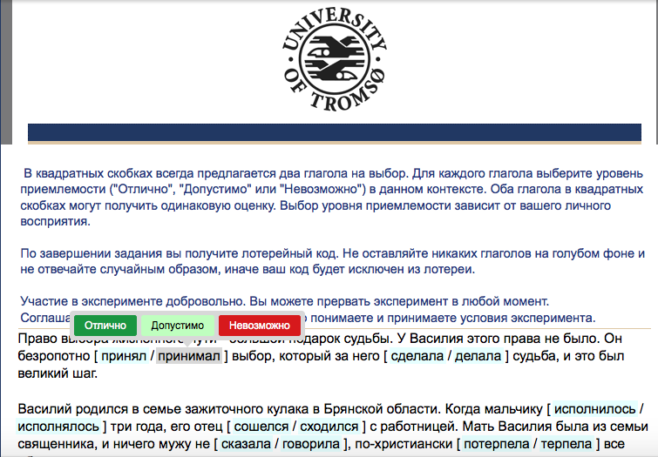
What our experiment looked like:

Slide 11
Results of experiment
Ordered categorical regression model shows:
The only really robust affect is whether the item being rated was the original aspect or not
Frequency has very little effect
No statistical difference between items with a known construction and those without

Slide 12
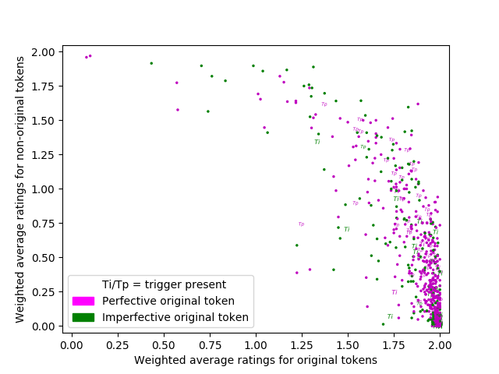
Distribution of responses

Slide 13
81% of responses are rather categorical.
Speakers reliably prefer the original aspect and disprefer the opposite aspect.

Slide 14
Examples of categorical responses
V vosem’ let mal’čik [ ^{original}sbežal / ^{non-original}sbegal ] iz doma.
‘At the age of eight the boy ran away from home.’
Bogomol’naja ženščina nikogda ne [ ^{non-original}obrugala / ^{original}rugala ] ego
‘The pious woman never yelled at him’
 | Impossible | Acceptable | Excellent
Perfective ^{original}sbežal | 0 | 0 | 83
Imperfective ^{non-original}sbegal | 69 | 12 | 2
Perfective ^{non-original}obrugala | 80 | 3 | 0
Imperfective ^{original}rugala | 0 | 0 | 83

Slide 15
17% of responses are ambivalent.
Speakers accept both aspects.

Slide 16
Examples of ambivalent responses
On umel nezametno [ ^{original}vytaščit’ / ^{non-original}vytaskivat’ ] den’gi iz karmana zevaki.
‘He knew how to pluck the money out of the pocket of an idler without being noticed.’
Vyživšuju iz uma staruxu nikto vser’ez ne [ ^{non-original}prinjal / ^{original}prinimal ]
‘No one took the senile old woman seriously’
 | Impossible | Acceptable | Excellent
Perfective ^{original}vytaščit’ | 10 | 41 | 32
Imperfective ^{non-original}vytaskivat’ | 2 | 25 | 56
Perfective ^{non-original}prinjal | 9 | 31 | 43
Imperfective ^{original}prinimal | 4 | 25 | 54

Slide 17
There are no groups in this data!
What constructions drive this distribution?

Slide 18
Ambivalent and categorical constructions

Slide 19
Aspectually ambivalent constructions
Categorical constructions selecting perfective or imperfective

Slide 20
Aspectually ambivalent constructions
Constructions that are neither categorical nor ambivalent
Categorical constructions selecting perfective or imperfective

Slide 21
Aspectually ambivalent constructions: Future tense
V dve tysjači pjatom godu my [ ^{non-original}otmetim / ^{original}budem otmečat’ ] šestidesjatiletie okončanija Velikoj Otečestvennoj vojny
‘In 2005 we will celebrate the 60th anniversary of World War II’
Èti kompanii, ne sgovarivajas’, bystro i èffektivno [ ^{original}vospolnjat / ^{non-original}budut vospolnjat’ ] ljuboj deficit sprosa na židkie uglevodorody bez ogljadki na politiku i “patriotizm”
‘these companies without conspiring will quickly and effectively supply any deficit in the demand for liquid hydrocarbons without regard for politics and patriotism’
estestvenno do konca my peškom ne dojdem, gde-nibud’ tam avtobus [^{original}pojmaem / ^{non-riginal}budem lovit’ ]
‘of course we are not going to get there on foot, we will catch a bus somewhere’

Slide 22
Aspectually ambivalent constructions: Other Potentiality
Vasilij umel [ ^{original}stat’ / ^{non-original}stanovit’sja ] dlja načal’nika neobxodimym.
‘Vasilij knew how to become necessary for the boss.’
Prosto v monokul’ture ediničnaja mutacija, obespečivajuščaja zaščitu ot dannogo spejsera, srazu daet virusu ogromnoe preimuščestvo (poskol’ku pozvoljaet [ ^{original}zarazit’ / ^{non-original}zaražat’ ] ljubuju bakteriju)
‘It’s simply the case that in a monoculture a single mutation that ensures protection from a given spacer, immediately gives that virus an enormous advantage (since it makes it possible to infect any bacteria)
im nado [ ^{non-original}vosstanovit’ / ^{original}vosstanavlivat’ ] utračennyj v gody sankcij èksportnyj potencial
‘they have to reestablish the export potential that was lost during the years of sanctions’

Slide 23
Aspectually ambivalent constructions: Verbal behavior
[ ^{non-original}Sprosili / ^{original}Sprašivali] u nas, otkuda my, čego my tut delaem
‘they asked us where we are from, what we are doing here’
Pozdnee tešča otkryto [ ^{non-original}obvinila / ^{original}obvinjala] ego v vorovstve.
‘Later his mother-in-law openly accused him of theft.’
Pered pensiej emu [ ^{non-original}predložili / ^{original}predlagali] porabotat’ neskol’ko let za granicej
‘Before retirement they suggested to him that he work abroad for a few years
kak ja uže [^{original}skazal / ^{non-original}govoril]
‘as I said before’

Slide 24
Aspectually ambivalent constructions: Multiple events
v trex slučajax iz ětix pjati u bakterij [^{original}sformirovalos’ / ^{non-original}formirovalos’] ne po odnomu, a po dva ili bolee protivovirusnyx spejserov
‘in three out of five cases of bacteria formed not one but two or more antivirus spacers’
v bol’šinstve slučaev [^{original}zakrepilis’ / ^{non-original}zakrepljalis’] mutacii, delajuščie sootvetstvujuščij spejser neèffektivnym
‘in most cases mutations took hold that made the corresponding spacer ineffective’

Slide 25
Perfective constructions: net-net da i V-fut-Perf ‘now and again X’
Ivanu Dmitrieviču vosem’desjat dva goda, a v glazax ego do six por net-net da i mel’knet ozornaja lukavinka.
‘Ivan Dmitrievič is 82 years old, but mischievousness still flashes in his eyes now and again.’

Slide 26
Perfective constructions: if X-fut-Perf, then Y-fut-Perf
Pomnite slova Vladimira Putina o katastrofe, kotoraja nastupit, esli cena barrelja opustitsja niže 80 dollarov?
‘Do you remember what Vladimir Putin said about the catastrophe that will come if the price of a barrel of oil will sink below $80?’

Slide 27
Perfective constructions: vremja NP-Gen prošlo ‘the time of X is over’
vremja neftjanyx zagovorščikov i manipuljatorov prošlo
‘the time of petroleum conspirers and price-fixers is over’

Slide 28
Perfective constructions: probyt’ + duration/termination point ‘spend time’
Ja desjat’ dnej v sančasti probyl, i vse, opjat’ v stroj.
‘I spent 10 days in the infirmary, that was all, and then back to the unit.’
Pod Xar’kovom probyli do sorok vtorogo goda, do pjatnadcatogo maja.
‘We were on the outskirts of Kharkiv until 1942, until 15 May.’

Slide 29
Russian aspect in the Russian Constructicon

Slide 30
The Russian Constructicon
Joint project of HSE and UiT
Over 600 entries so far
Part of a multinational project, including English, Brazilian Portuguese, German, Japanese, Swedish
Shared parallel architecture, open-source, free and public
https://spraakbanken.gu.se/karp/#?mode=konstruktikon-rus
Crowdsourcing Googlesheet: https://tinyurl.com/yah8ejlu
Funded by: Norwegian Centre for International Cooperation in Education (2016, 2018-2020), Higher School of Economics in Moscow, and UiT

Slide 31
Priorities of the Russian constructicon
Multiword constructions
At least one “slot” that can be filled with a range of words (semantic restrictions)
Meaning is not necessarily compositional, challenging for L2 learners
Items that are not adequately represented in dictionaries
X так и не Vpast, as in Он так и не женился [He thus and not married] ‘But he didn’t get married after all’
возьми и Vimper, as in А он возьми и купи новую машину! [And he take! and buy! new car] ‘And he went and bought a new car!’

Slide 32
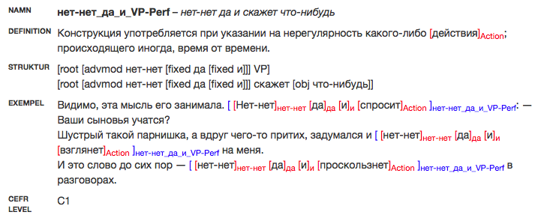
Sample entry from the Russian Constructicon: net-net da i V-fut-Perf ‘now and again X’

Slide 33
Perfective constructions in the Russian Constructicon
(NP-Nom) только что VP-Perf.Past Вася только что принес деньги
NP как VP-Perf а потом у него как затрясутся руки
NP-Nom как VP-Fut.Perf! Вся волчья стая как набросится на меня!
Pron-Nom у меня VP-Fut.Perf ты у меня попляшешь
VP-Imper, а (не то) VP-Perf.Fut поспеши, а не то опоздаешь на экзамен
VP-Perf в два счёта договориться в два счёта
грех не VP-Perf.Inf грех не выпить
зайти VP-Inf.Perf Я зашел поговорить
не грех и VP-Perf.Inf теперь не грех нам и отдохнуть
нет-нет да и VP-Perf нет-нет да и скажет что-нибудь
стоить (NP-Dat) VP-Perf, как Cl стоило ей отвернуться, как он сбежал
того и гляди VP-Perf того и гляди конфеты съест
чтоб Pron-Nom VP-Past.Perf! чтоб он пропал!

Slide 34
Imperfective constructions in the Russian Constructicon
(NP-Dat) грех VP-Inf.Imp грех обижаться на взрослых
(всё) никак не VP-Imp задача всё никак не решалась
NP-Nom без устали VP-Imp жена без устали готовила на кухне
NP-Nom всё V-Imp Вася всё писал
NP-Nom терпеть не мочь NP-Acc/VP-Inf.Imp Я терпеть не могу соревноваться!
VP-Imp одно и то же писал он всегда одно и то же
VP-Imp почём зря Паша ругается почём зря каждый день
всё VP-Imp С самого приезда в Пекин он всё грустил.
всё VP-Imp да VP-Imp мальчик всё шёл да шёл
мочь-Past бы и не VP-Inf.Imp Мог бы и не спрашивать о моём настроении
не смей VP-Inf.Imp не смей ругаться
никак не VP-Imp я никак не контролирую его действия
какой VP-Inf.Imp! какой спать!

Slide 35
Conclusions
There is a range of constructions that interact with the grammatical category of aspect in Russian
Some constructions strongly determine aspect, and these are also represented to some extent in the Russian Constructicon
Constructions that are ambivalent to aspect are not represented, nor are constructions that merely give strong tendencies with respect to aspect

